Slide 1

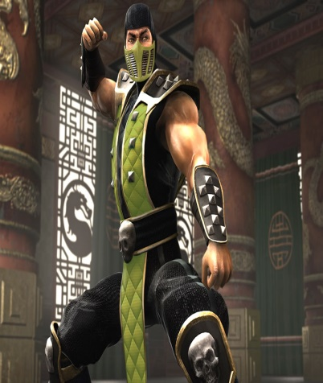
Teamwork JavaScript UI & DOM
Game: Super Mario
Team “Reptile”
Telerik Software Academy
academy.telerik.com

Slide 2
Game features
Welcome screen
Super Mario
Enemies
Sound
Game over screen
Highscore

Slide 3
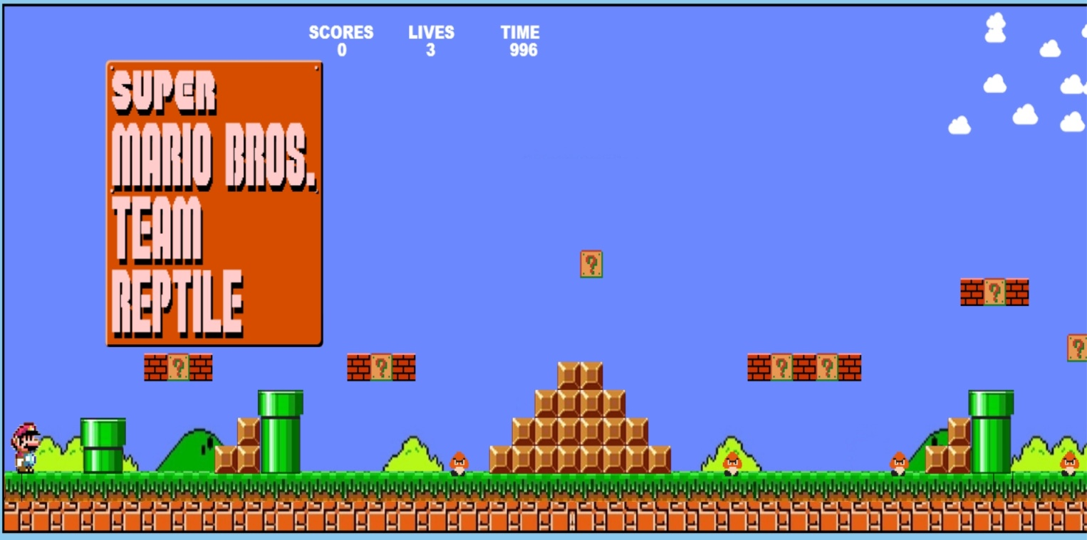
In game features
Score
Super Mario
Enemies

Slide 4
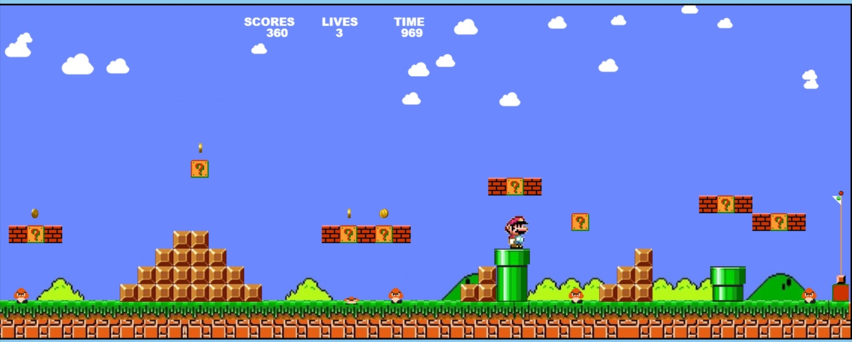
More in game features
Coin
Dead enemy

Slide 5
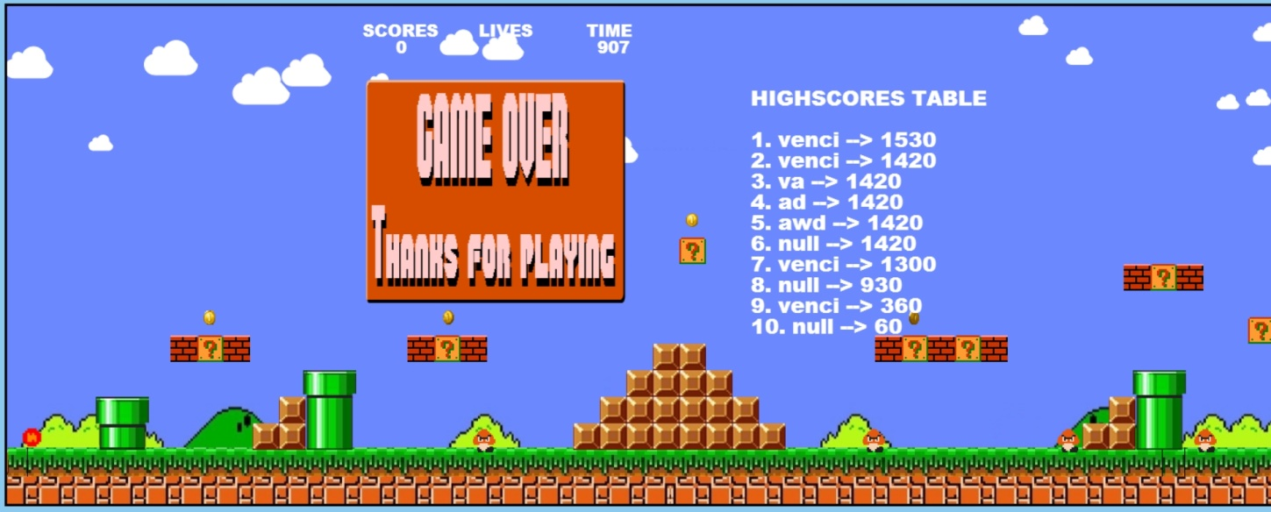
More in game features

Slide 6
Team members:
Венцислав Кулин
Калина Лазарова
Диана Станчева
Деян Вълканов
Николай Кичев
Самуил Петров
Андрей Благоев

